Slide 1
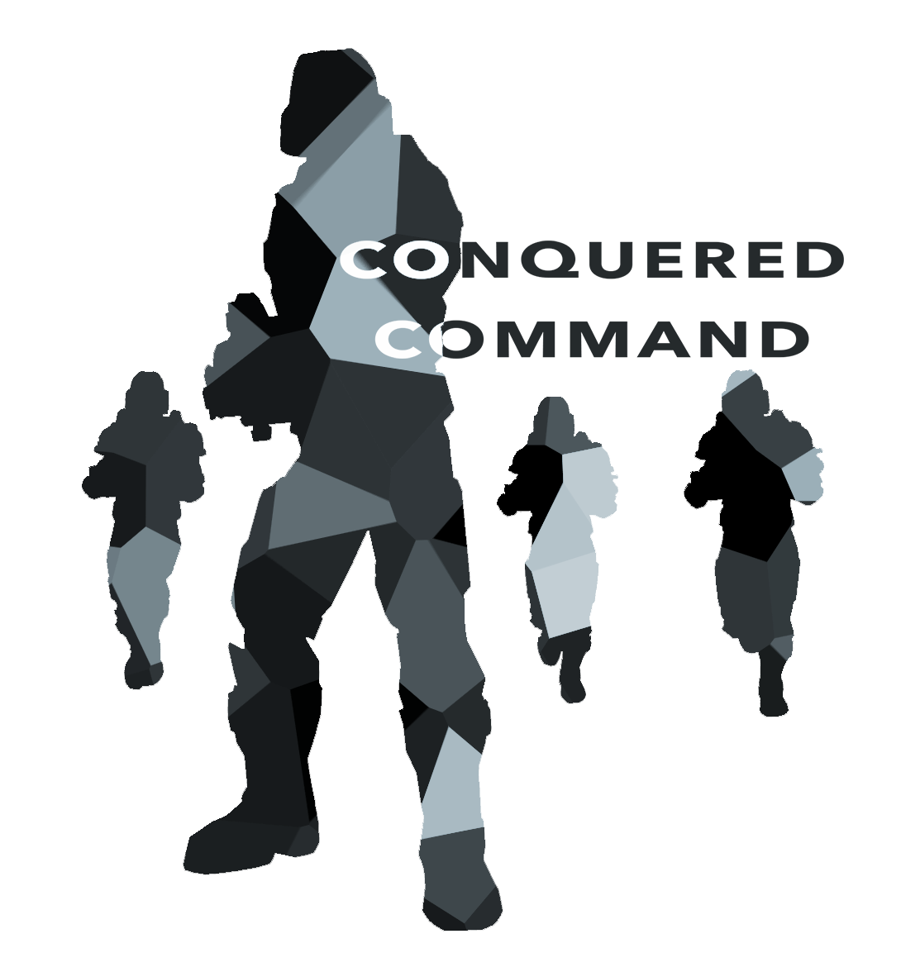
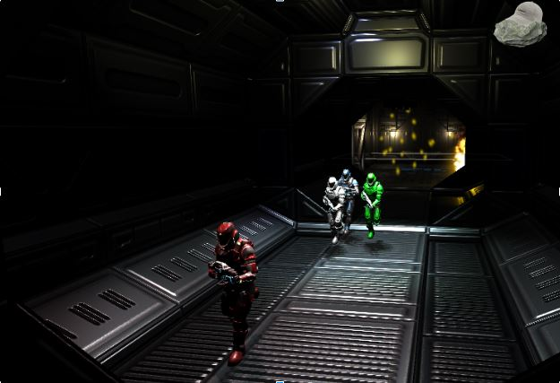
Game Story On a space station conquered by murderous aliens with no hope of rescue or reinforcements, four astronaut marines form a team to repair and liberate the station, wing by wing, from the aliens’ control.
Game Play Conquered Command is an action role-playing game (ARPG). The player characters gain experience by defeating enemies, earn bonus attribute points at each new experience level, and unlock new combat abilities. To win, the player must solve puzzles, strategize battles, and defeat the enemy aliens.
Game State
-Game state (player state, position in level) is transferred between scenes in an XML file created from serialized game objects
- These files can be loaded from the main menu
Notes:
SECTIONS:
Abilities - nick
Co-op AI - nick
Enemy AI - josh
Level Design - brett
Puzzles - andrew
Game State - claudia

Slide 2
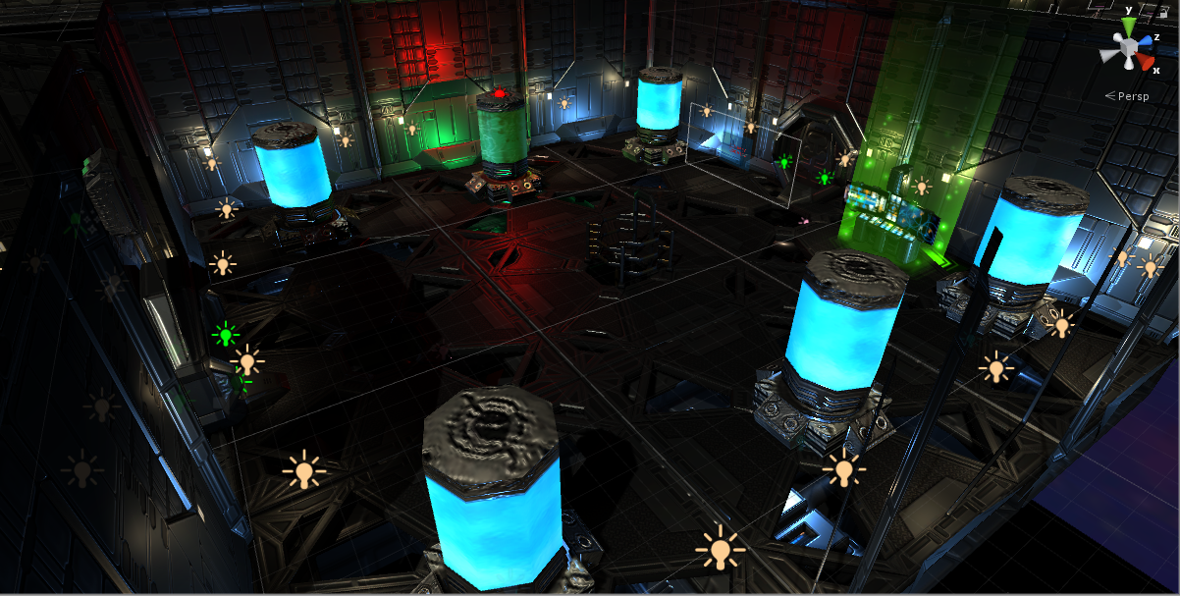
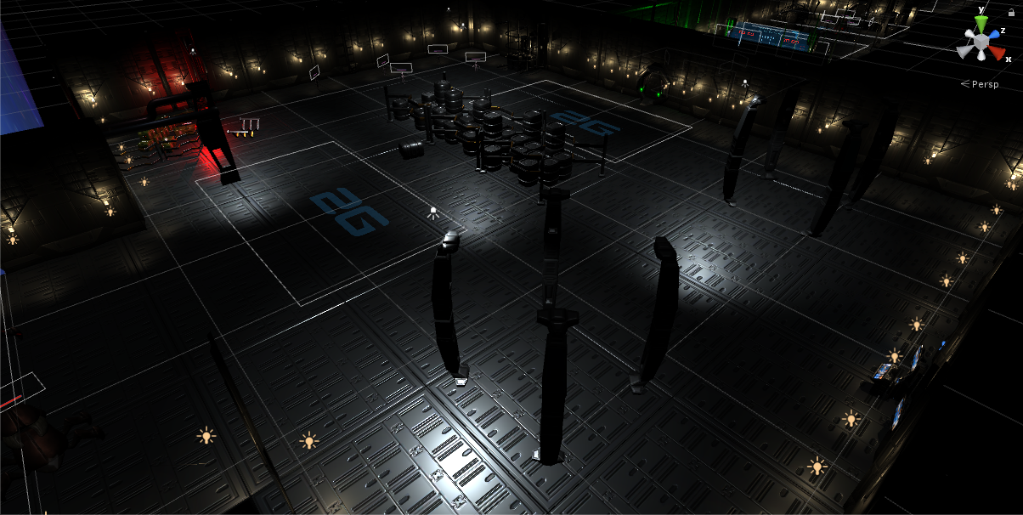
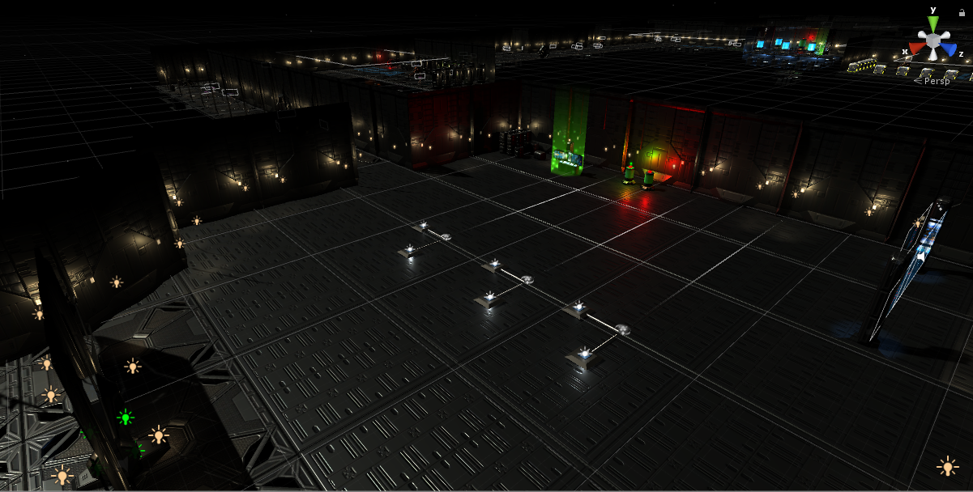
Level Design
3 levels implemented
Level 1 (large)
Level 2 (medium)
Level 3 (boss)
Sci-Fi Heavy Base Station Level builder assets used to build the main level pieces
Various props from several authors comprise the in-scene props
Particle effects on some props for visual effect
Music unique to each level
3D sound effects attached to particle effects, volume varies with distance
Notes:
SECTIONS:
Abilities - nick
Co-op AI - nick
Enemy AI - josh
Level Design - brett
Puzzles - andrew
Game State - claudia

Slide 3
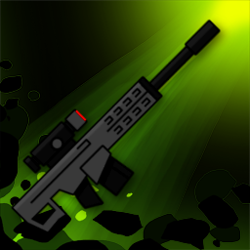
Abilities
As the player defeats enemies, the squad earns stat points to spend in three attributes: Strength, Intelligence, and Stamina. By spending stat points, each character will unlock abilities to use in battle. There are 19 abilities in total and range from sentry turrets to healing fields. Abilities icons are shown to player in a tree structure, where branches of the tree correspond to the attributes above. Crossover branches require stat points in the two neighboring attributes. Abilities that are further down a branch require more stat points to unlock.
//See notes if you want to add more about ability implementation
Cooperative AI
The player switch control between any of the four soldiers. However, when not in player control, cooperative AI teammates will enter a state machine to assist the player. Teammates will follow the player, chase and shoot nearby enemies, use abilities, and flee from battle if the active player runs away. Each AI player keeps track of their own visible enemies while simultaneously updating the entire team’s knowledge. The attacking behavior of co-op AI can be customized to target the enemy that is closest, has the lowest health, or is the active player’s target. The frequency and types of abilities teammates use can also be customized. When selecting an ability to use, the AI player will consider its surroundings such as their current health, number of enemies, and other factors.
Notes:
//Class and Implementation details
Each ability exists as its own class that implements the interface IAbility. By implementing the interface, scripts can access information about the ability such as its cooldown time, energy required to use, and an Execute() method when the player uses it. If the ability is complex, the class can either call methods in the AbilityHelper MonoBehaviour script which can handle coroutines or instantiate projectiles with a script attached. Each ability has an “Action” or type that can be accessed by the Player or Co-op AI controlling script. The Action determines which code should be run to execute the ability.
and are as follows:
Target: Requires the user to click on a visible enemy or ally, then fires the ability at the target.
Examples: Zap, Revive, Leech Dart.
AOE (Area of Effect): Requires the user to aim a spinning circle to select targets.
Examples: Grenade Throw, Shield Booster, Shockwave. Note: AI Teammates simplify AOE abilities by picking a specific enemy or ally as the center of the circle.
Equip: Uses the ability instantly on keypress and may disable the player’s basic attack for a duration.
Examples: Medkit, Stimpak, Flamethrower
Basic: Basic abilities do not take a slot on the ability bar. They are used continuously after right-clicking an enemy.
Examples: Sniper Rifle, SMG, Shotgun

Slide 4
Abilities
Players defeat enemies to earn stat points.
Stat points can be spent on 3 attributes: Strength, Intelligence, and Stamina.
By spending stat points, characters unlock abilities to use in battle.
There are 19 abilities and include sentry turrets, lightning strikes, and healing fields
Abilities icons are shown to player in a tree structure (seen ____)
Each branch of the tree corresponds to an attribute
Crossover branches require stat points in the two neighboring attributes.
Abilities that are further down a branch require more stat points to unlock.
//See notes if you want to add more about ability implementation
Cooperative AI
The player can switch control between any of the four soldiers at any time.
When not in player control, a soldier enters an AI state machine to assist the player.
Teammates will follow the player, chase and shoot nearby enemies, use abilities, and flee from battle if the active player runs away.
AI players keep track of visible enemies while also updating the entire team’s knowledge.
AI can be customized to attack the closest, lowest health, or active player’s target.
The frequency and types of abilities teammates use can also be customized.
AI players consider their surroundings (current health, number of enemies) to select an ability.
Notes:
//Class and Implementation details
Each ability exists as its own class that implements the interface IAbility. By implementing the interface, scripts can access information about the ability such as its cooldown time, energy required to use, and an Execute() method when the player uses it. If the ability is complex, the class can either call methods in the AbilityHelper MonoBehaviour script which can handle coroutines or instantiate projectiles with a script attached. Each ability has an “Action” or type that can be accessed by the Player or Co-op AI controlling script. The Action determines which code should be run to execute the ability.
and are as follows:
Target: Requires the user to click on a visible enemy or ally, then fires the ability at the target.
Examples: Zap, Revive, Leech Dart.
AOE (Area of Effect): Requires the user to aim a spinning circle to select targets.
Examples: Grenade Throw, Shield Booster, Shockwave. Note: AI Teammates simplify AOE abilities by picking a specific enemy or ally as the center of the circle.
Equip: Uses the ability instantly on keypress and may disable the player’s basic attack for a duration.
Examples: Medkit, Stimpak, Flamethrower
Basic: Basic abilities do not take a slot on the ability bar. They are used continuously after right-clicking an enemy.
Examples: Sniper Rifle, SMG, Shotgun

Slide 5
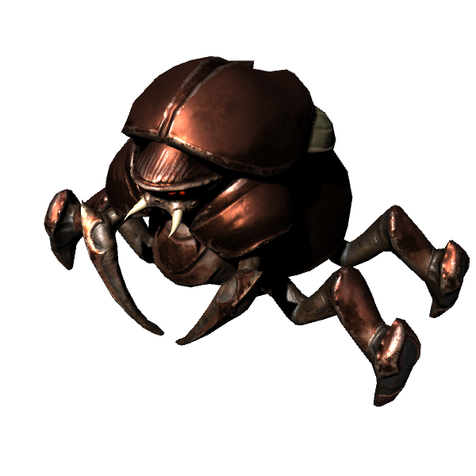
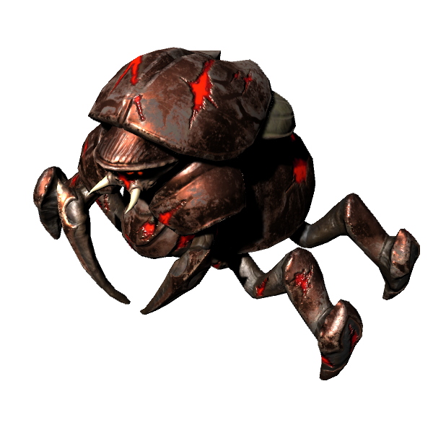
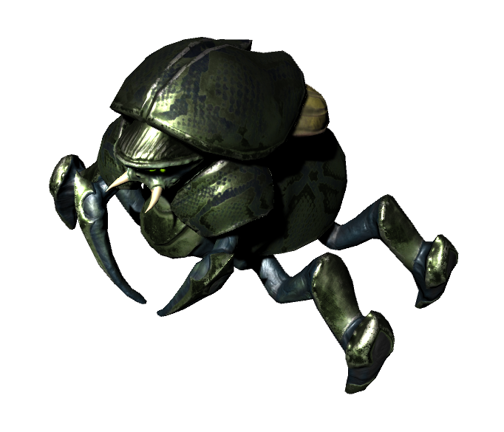
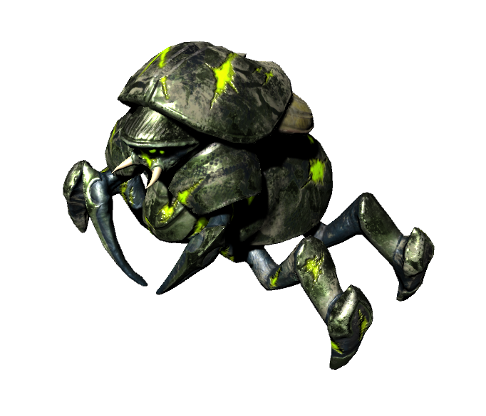
Enemy AI
Each enemy has individual vision sphere that triggers whenever a player enters them
Perform raycasts to players in vision sphere to detect if vision is occluded by scenery
Upon successful raycast, enemies will enter an aggroed state, where they will chase players until either
The enemy dies
All players in vision die
No more players can be seen
In addition, enemies can share their knowledge of visible players within their enemy mob group, which is a pooled knowledge resource for nearby enemies
Enemy mobs can use two different strategies to determine targets for the enemies within the mob:
Even - Enemies will distribute evenly amongst all players in the mob’s vision
Random - Enemies will randomly choose their targets from those within the mob’s vision
When enemies enter a certain range of the player, they will enter an attacking state. Attacking animations contain animation events that deal damage to the players
I figure these pictures of the enemies with transparent backgrounds could be useful for the poster/design doc.

